Slide 1
Secure Data hiding in image using Steganography
CAPSTONE PROJECT
Presented By:
Student Name : Nishant Mall
College Name & Department : Deen Dayal Upadhyaya Gorakhpur University (Information Technology [IT])

Slide 2
OUTLINE
Problem Statement
Technology used
Wow factor
End users
Result
Conclusion
Git-hub Link
Future scope

Slide 3
Problem Statement
As cyber threats grow, traditional encryption is easily detectable, making data vulnerable. Steganography offers a discreet alternative by hiding messages in images. This project converts text into ASCII values, embeds them in pixel data, and encrypts the image. Decryption requires a correct passcode, ensuring secure access.
Key Aspects:
Hides text in image pixels using ASCII values.
Encrypts and saves the modified image.
Ensures decryption only with the correct passcode.
Retrieves and reconstructs the message upon authentication.

Slide 4
Technology used
Programming Language: Python – Used for implementing steganography and handling image data.
Development Platform: Visual Studio Code (VS Code) – The IDE used for writing and running the code.
Execution Environment: Python interpreter – Required to execute the script with necessary dependencies installed.
Libraries:
OpenCV (cv)– Handles image reading, pixel modification, and saving the encrypted image.
os – Manages file operations, such as opening the encrypted image.

Slide 5
Wow factors
Steganography-Based Security: Unlike traditional encryption, this method hides messages within images, making them less detectable.
Direct Pixel Embedding: Stores data directly in image pixels without requiring separate metadata or external files.
Passcode Authentication: Adds an extra layer of security by ensuring only authorized users can decrypt the message.
No Specialized Tools Required: Runs on Python with basic libraries, making it accessible without advanced cryptographic tools.

Slide 6
End users
Cybersecurity Enthusiasts – Individuals interested in learning and experimenting with steganography for secure communication.
Journalists & Whistleblowers – Those needing discreet methods to share sensitive information without detection.
Researchers & Students – Academics exploring data hiding techniques and encryption alternatives.
Individuals Seeking Privacy – Anyone looking for a simple yet effective way to protect personal messages from interception.

Slide 7
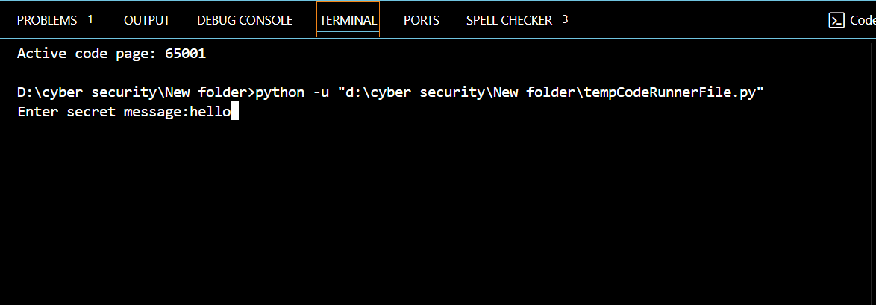
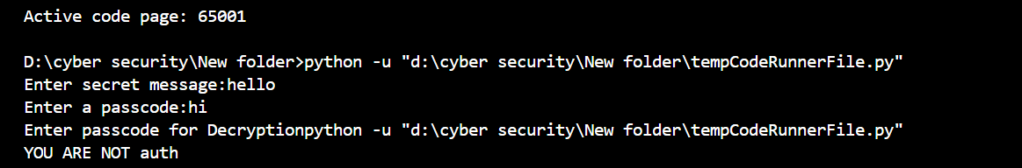
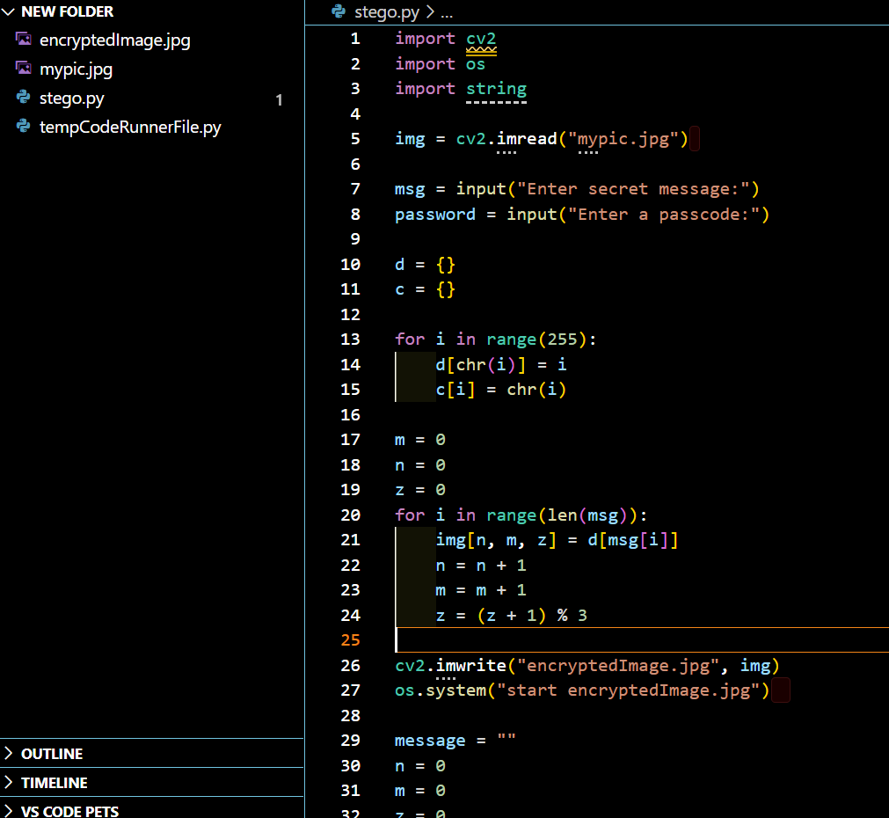


Results
VS code Terminal :
VS code Terminal :
Encryption Code :
Input Image File :
Output Image File :

Slide 8
Conclusion
This project demonstrates a simple yet effective approach to secure communication using image steganography. By embedding messages in pixel data and protecting them with a passcode, it ensures discreet and controlled access. Its lightweight implementation makes it accessible for learning and real-world applications.
Key Takeaways:
Steganography enables hidden message transmission without drawing attention.
Passcode protection ensures only authorized decryption.
Simple implementation makes it easy to use and integrate into security applications.

Slide 9
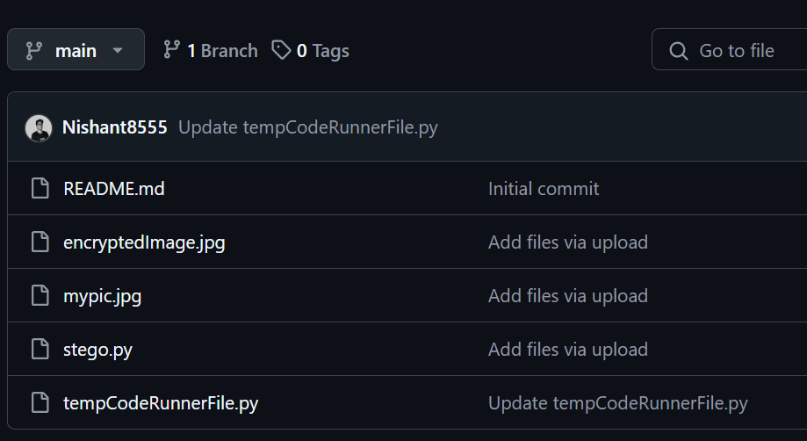
GitHub Link
https://github.com/Nishant8555/edunet.git

Slide 10
Future scope
Enhanced Security: Implement stronger encryption algorithms alongside steganography for added protection.
Increased Capacity: Optimize data embedding to store larger messages without noticeable image distortion.
Multi-Format Support: Extend functionality to support video and audio steganography.
AI Integration: Use machine learning to detect and prevent unauthorized steganographic attacks.

Slide 11
THANK YOU AICTE Internship Student Registration ID : STU61d182598c2f51641120345 Email ID : nishantmall8555@gmail.com

